Slide 1


MINI PORTOFOLIO
data science
digital skill fair 29.0 by dibimbing using Phyton

Slide 2

GET TO KNOW ME
Hello, my name is Harirah Layyinah Ahmada. I'm an undergraduate physics student at Sepuluh Nopember Institute of Technology. I have developed strong analytical and problem-solving skills, as well as a deep understanding of mathematical and statistical concepts. I am now directing my interest to the field of data science, where I believe my skills and knowledge can make a significant contribution. I have taken additional courses and training in programming (Python) and data analysis to strengthen my technical skills. I believe that the analytical and rigorous approach that I developed during the lectures will be a valuable asset in analyzing data and providing meaningful insights.

Slide 3



CONVERSION OF TEMPERATURE
from Celcius to Farenheit

Slide 4
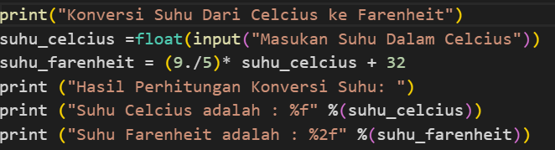

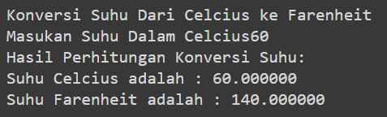
CONVERSION OF TEMPERATURE FROM CELCIUS TO FARENHEIT
obtained a chart for the conservation of temperature from celcius to farenheit by inserting the temperature of the way of the unit of celcius into the chart will result in the temperature in the units of farenheit

Slide 5
DETERMINES A NUMBER
Based on Strange and Even

Slide 6
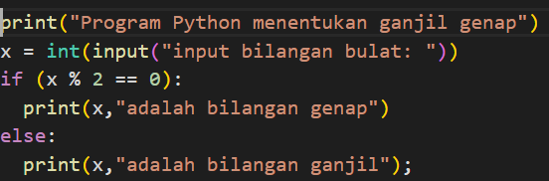



DETERMINES STRANGE AND EVEN NUMBERS
obtained a chart to determine a number including a strange or even number by entering a number. and will be known such numbers including strange or even numbers

Slide 7
POKEMON
Data sheet

Slide 8

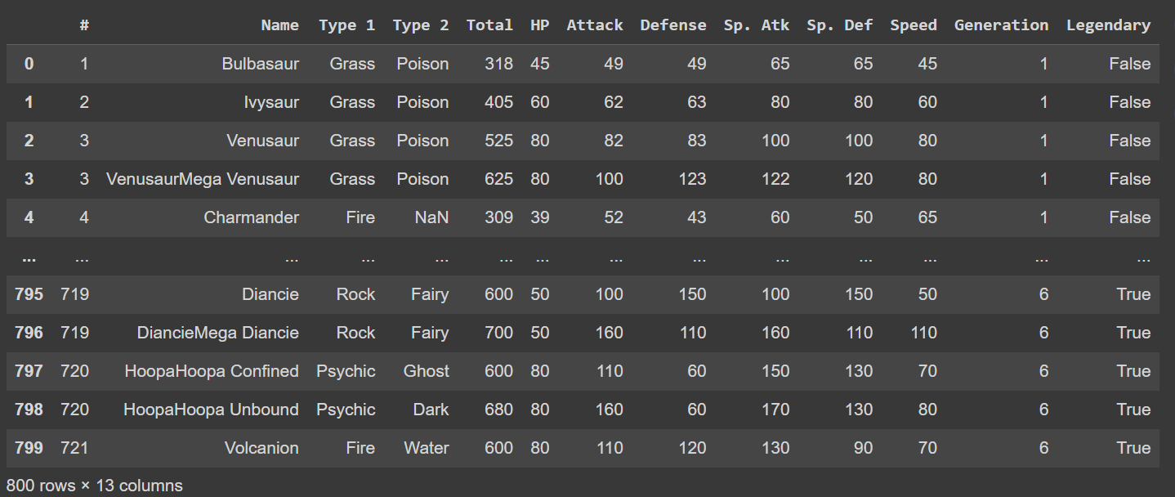

Slide 9



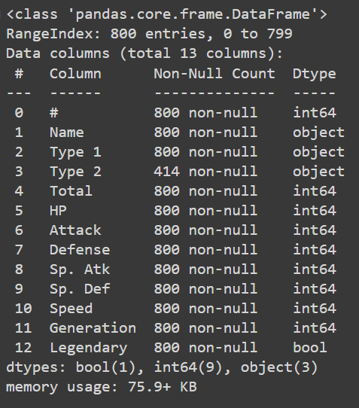

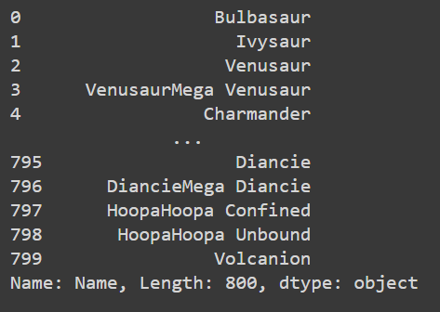

Slide 10

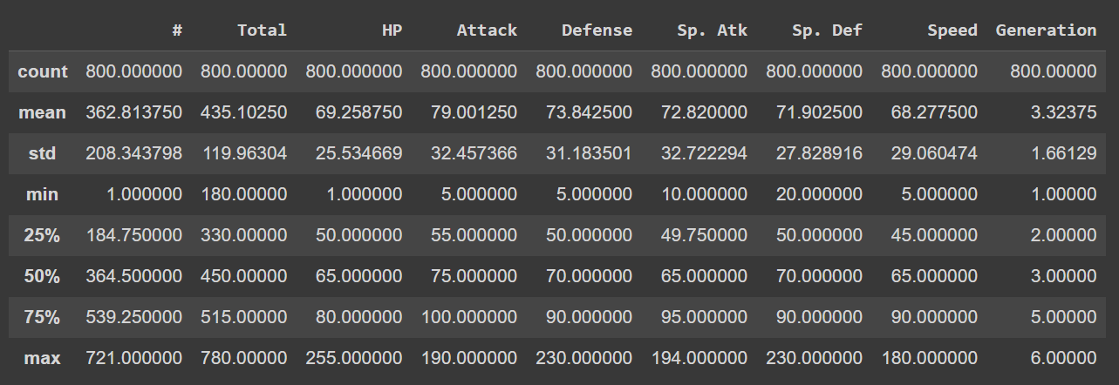

Slide 11
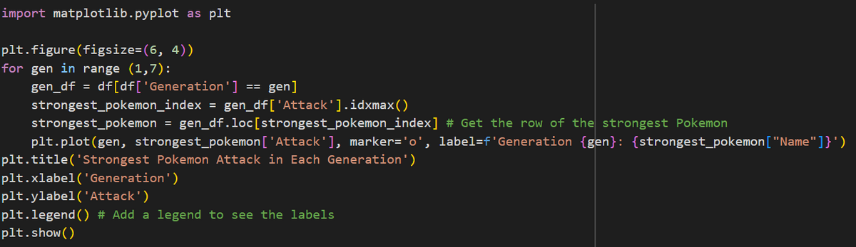
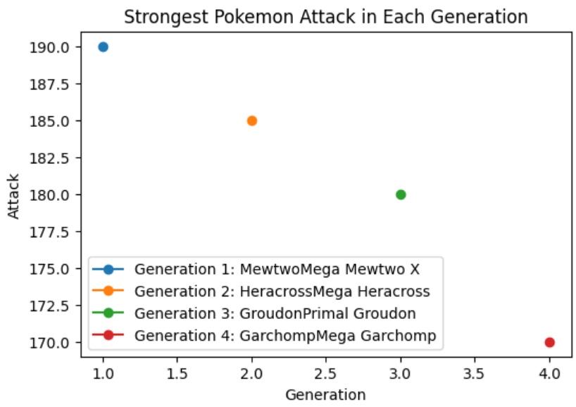
STRONGEST POKEMON BASED ON ATTACK IN EACH GENERATION
In the first generation, the strongest pokemon is the MewtwoMega Mewtwo X with a score of 190.0. in the second generation, the strongestt pokemon is HeracrossMega Heracross with a score of 185.0. in the third generation, the strongest pokemon is the GroudonPrimal Groudon with a score of 180.0. and in the fourth generation, the strongest pokemon is the GarchompMega Garchomp with a score of 170.0.

Slide 12
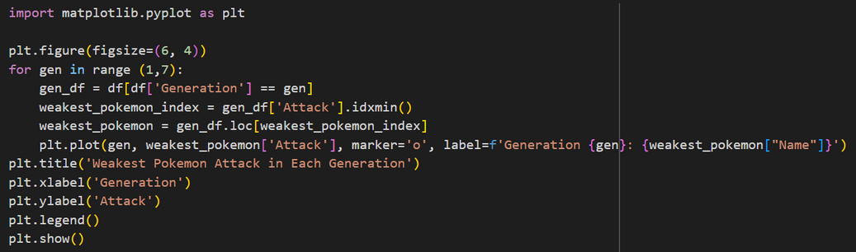
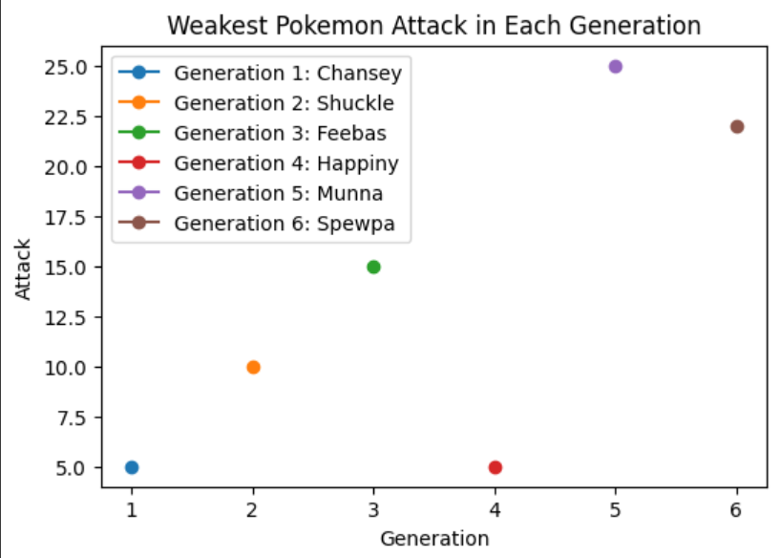
WEAKEST POKEMON BASED ON ATTACK IN EACH GENERATION
In the first generation, the weakest pokemon is the Chansey with a score of 5.0. in the second generation, the weakest pokemon is Shuckie with a score of 10.0. in the third generation, the weakest pokemon is the Feebas with a score of 15.0. in the fourth generation, the weakest pokemon is the Happiny with a score of 5.0. in the fifth generation, the weakest pokemon is the Munna with a score of 25.0. and the sixth generation, the weakest pokemon is the Spewpa with a score of 22.5.

Slide 13
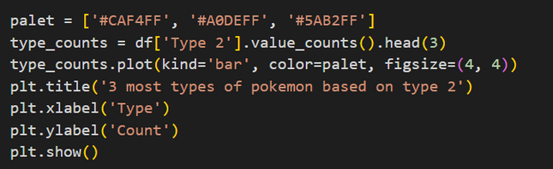
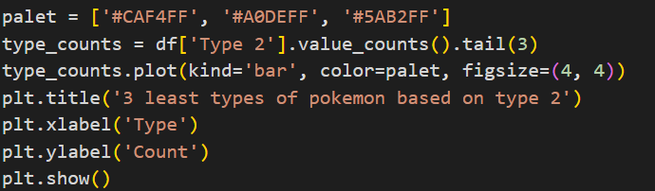
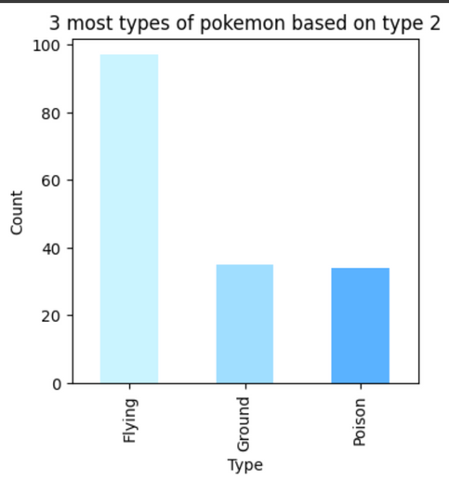
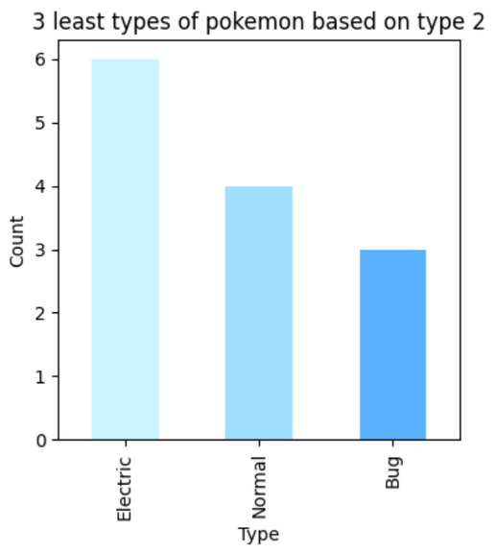
3 TYPES MOST AND LEAST BASED ON TYPE 2
Based on type 2, it is known that there are three most types of pokemon there are flying, ground, and poison.
Based on type 2, it is known that there are three least types of pokemon there are electric, normal, and bug.

Slide 14
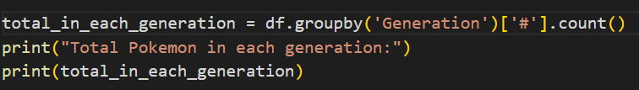
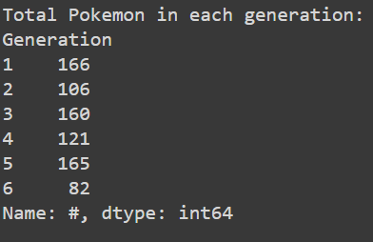
TOTAL POKEMON IN EACH GENERATION
based on datasheet it is known that there are six generation. The first generation has the highest number of total pokemon (166), followed by fifth generation (165), third generation (160), forth generation (121), secind generation (106), and last sixth generation (82).

Slide 15
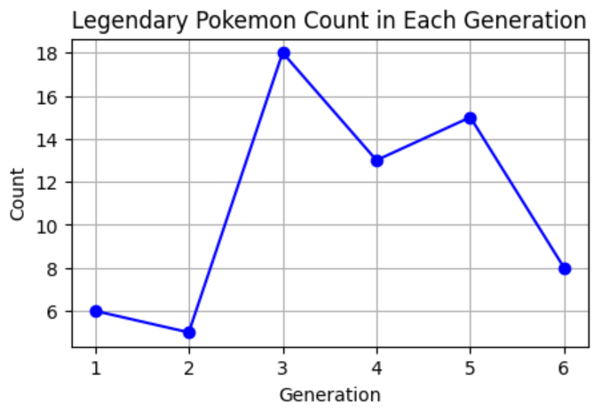

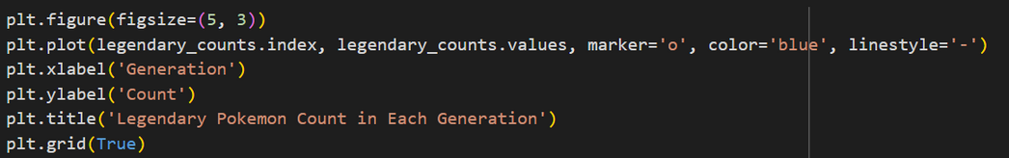
LEGENDARY POKEMON COUNT IN EACH GENEGRATION
There are true legends in each generation. The most true legend is from the third generation (18). followed by the fifth generation (15), the fourth generation (13), the sixth generation (8), the first generation (6), and the last second generation (5).

Slide 16
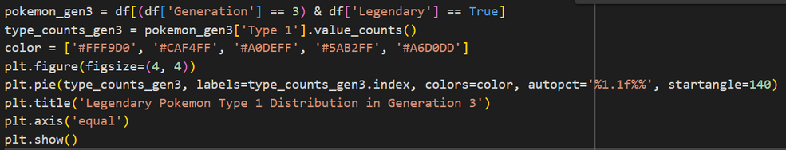
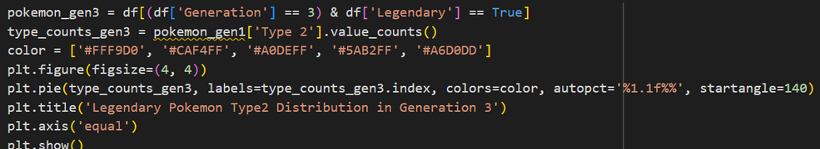

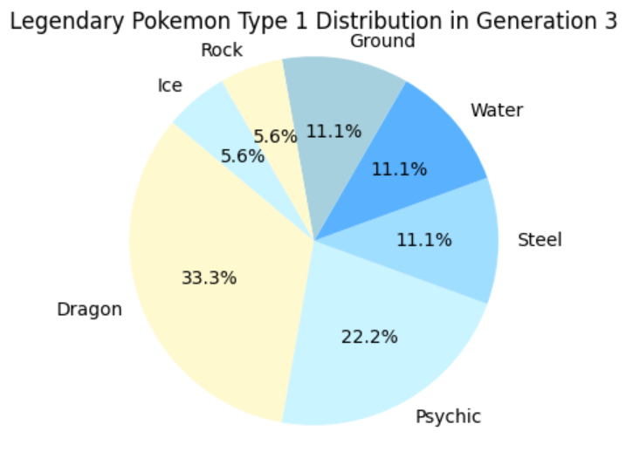
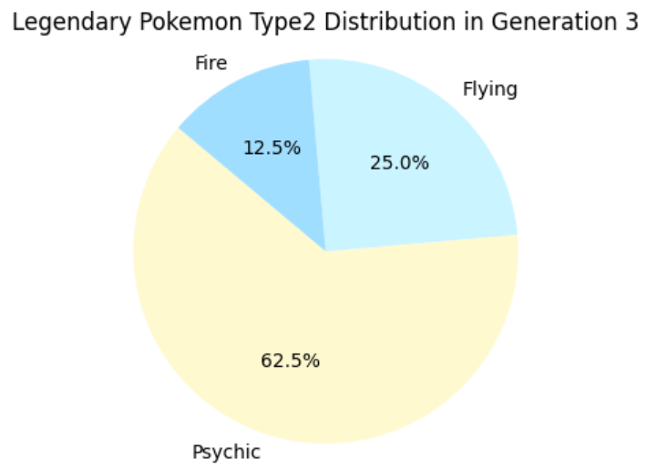
POKEMON TYPE 1 AND 2 DISTRIBUTION IN GENERATION 3

Slide 17
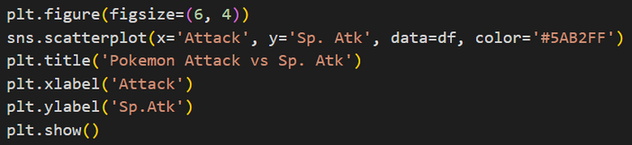
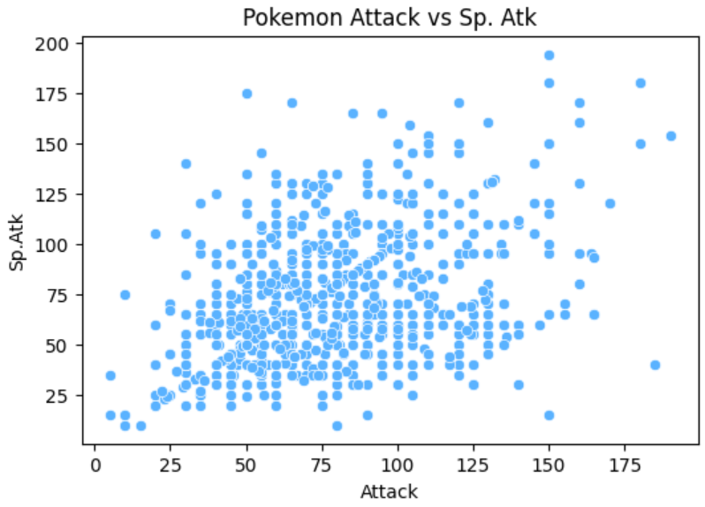
POKEMON ATTACK VS SP.ATTACK
A scatter diagram, also known as a transmitter diagram is a visual tool used in data analysis to show the relationship or correlation between two variables. This diagram uses a horizontal (Attack) and a vertical (Sp. Atk) axis to display the data points representing the values of the two variables. Each point on the diagram represents a pair of values from the two observed variable. The use of a scatter diagram helps in visualizing patterns or relationships between the variables intuitively. if the data points tend to cluster around a straight line that climbs from left to right, indicates a positive correlation. That is, both variables tend to increase simultaneously. On the contrary, if the points decrease from the left to the right, it indicates negative correlations, where one variable increases while the other decreases.

Slide 18


THANK
You
harirahahamada28@gmail.com
Harirah Layyinah Ahmada
@hhar._

